Slide 1
General Meeting #11
DATA NORMALIZATION METHODS
October 31th, 2021

Slide 2
Previous Discussion of Techniques
BRIEF REVIEW OF WHAT WE WENT OVER LAST MEETING

Slide 3
Data Normality
KEY TAKEAWAYS
From last lecture we know that it is important for data to be normal before it is put into a linear model
This anchors a large number of assumptions of linear regression
Also a factor in most statistical tests that we are going to be using
We describe data as normal if it follows the normal curve
A curve is “Normal” if it is part of the normal curve family
These curve can be described with two points: mean and standard deviation
Normality can be seen in many normal systems and populations ”out in the wild
Remember our assumptions for using a linear regression: linearity, multivariate normality, little-to-no multicollinearity, no autocorrelation, and homoscedasticity

Slide 4
Defining Our Terms
GETTING INTO HOW TO NORMALIZE DATA

Slide 5
Where Normalization Falls
WHERE DOES NORMALIZATION APPEAR IN THE MODELING PROCESS
1. Collecting data
We can do this ourselves using webscraping
Remember the importance of sampling here
Can also use premade dataset (stock data)
2. Formatting data
Using Pandas here
3. Check linear modeling assumptions
If the assumptions fail and the data is not normal we need to normalize
We need to normalize the entire dataset even before the train-test split
Do this because we are going to apply the same normalization parameters from the training set to the testing set
4. Start to build the model and test
5. Deploy

Slide 6
Defining Normalization *Academically*
SOME QUICK DEFINITIONS
So far we have been using the term “normalization” rather broadly, lets me more specific with our language
Normalization: process of reshaping our data (e.g. change the mean and standard deviation) to fit a Gaussian normal curve
Allows for the meeting of a the normal assumption of normality
Scaling: changes the range that you data exists within
Helpful when you model uses distance because you want easy comparison between your factors
Allows for better weighing in your model and prevents the introduction of bias

Slide 7
Data Density
BRIEF ASIDE OF DATA DENSITY (MORE DEFINITIONS)
This will be quick
There are two types of data density:
Sparse
Dense
Can say that data is sparse when zero or non-existing values are common
For example, say we are tracking each time a professor walks into CBA 3.204
We say this is sparse because we would only get data when they entered the classroom
Data is dense when there is a constant metric of evaluation
For example, we were tracking the number of students that passed through the McCombs entrance in a timestep
There would always be a metric to record at each timestep
Impacts when to use standardization and scaling

Slide 8
Outliers
HOW DO WE DETECT OUTLIERS IN OUR DATA?
We can generally define outliers in our data as an observation that defers significantly from the central subset of our data
Outliers cause significant issues in our modeling process because they distribute our central prediction
Remember when looking at issues with OLS a single outlier could entirely destroy a model
There are a few methods for detecting outliers:
Scattergram: this allows you to visualize where outliers are located and record their indices
IQR: typically you calculate the Q1 and Q3 and outliers are classified as observations that sit 1.5x outside of either bound

Slide 9
Scaling
HOW TO SCALE

Slide 10
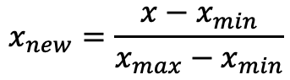
Min-Max Scaler
BASIC SCALING FUNCTION
The Min-Max Scaler will scale your values within an input range; a minimum and a maximum
This scaler should not be used sparse data because it destroys what a zero or non-observation is:
Going back to the door example, ”door not open” would have different meaning after rescaling
You also want to avoid scaling when there are strong outliers because this will unnecessarily reduce the granularity of the central observations
It is appropriate to scale data when you want two variables to be comparable
Especially, good for linear models because:
You often want to interpret the results of the linear model
If you put in vectors with drastically different scales it can skew the model (especially during for neural nets)
$$x_{new}=\frac{x−x_{min}}{x_{max}−x_{min}}$$

Slide 11
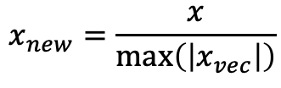
Max-Abs Scaler
BEHAVES SIMILAR TO MIN-MAX SCALER WHEN ONLY USING POSITIVE VALUES
We use the Max-Abs scaler when we do not want to destroy the sparsity of the data
This does not occur because we are taking the absolutely value of an input and using that to scale
Allows for us to to know that the absolute maximum value of the rescaled data will be 1
This scaler will also suffer the existence of large outliers
$$x_{new}=\frac{x}{max⁡\left(\left|x_{vec}\right|\right)}$$

Slide 12
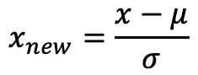
Standard Scaler
FINDS THE Z-SCORE FOR EACH OBSERVATION
We can define a normal curve by only its mean and standard deviation
Standard scaler will use this to force the existing data into a normal curve as well as scaling it
Remember for the normal curve that ~67% of observation fall within the first standard deviation
This will maintain the presence of outliers in your data if they are large
One of the more common methods because it reappears often through statistics
For example, the calculation of p-values
$$x_{new}=\frac{x−μ}{σ}$$

Slide 13
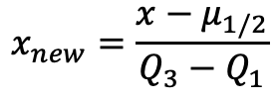
Robust Scaler
ROBUST TO OUTLIERS
In previous scalers we saw that they were sensitive to outliers, this scaler is not
Previously, we saw mean and standard deviation being used in scalers as a method of rescaling
Here we are using median and IQR which are as sensitive to a small number of large outliers
IQR was also the method of detect outliers (as evidence of this)
Performs the same process as the standard scaler (or the calculation of z-score) but with these variables instead
$$x_{new}=\frac{x−μ_{1/2}}{Q_{3}−Q_{1}}$$

Slide 14
Standardization

Slide 15
Log Transformation
VERY COMMON FORM OF STANDARDIZATION BECAUSE OF ITS EASY INTERP
We use a log transformation to convert values when they take up a wide range
A good example is income where there is a strong central subset but significant low and high outliers
To perform a log transformation we just take the log of each observation in a row
log(10) = 1
log(100) = 2
log(10000) = 4
As we can see this does an extremely good job scaling observations that are order of magnitudes larger than each other to be within the same range
If we transform the independent variable the beta now tells us that a 1% change in the x causes the beta effects on the dependent variable

Slide 16
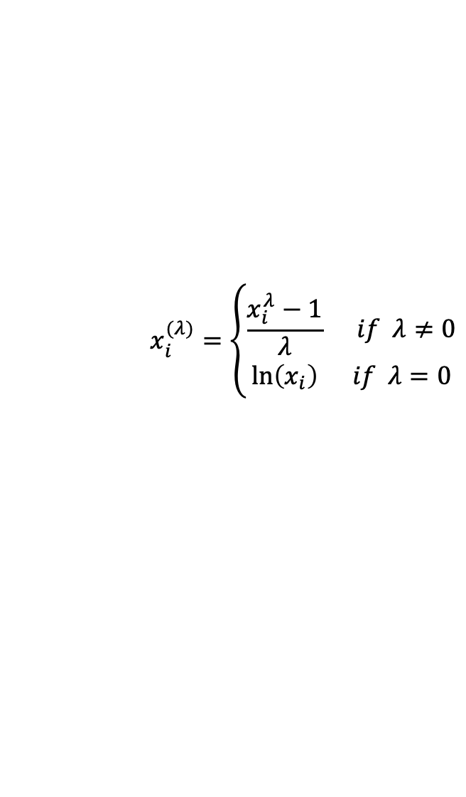
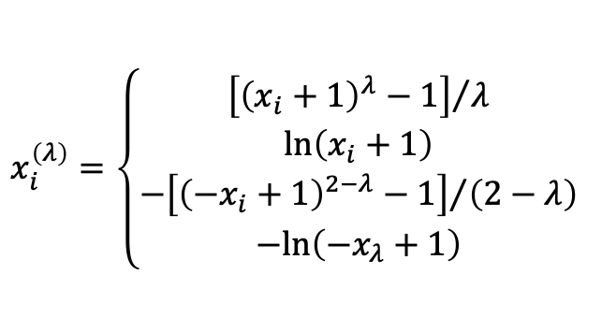
Box Cox Transformation
SIMILAR TO A LOG TRANSFORMATION
The BX transformation can only be applied to strictly positive values of y
Is used to transform the dependent variable into a normal curve
The lambda term is selected between -5 and 5
The optimal value of lambda is simple the term that best approximates the normal curve
A lambda term of 1 means that no transformation is necessary
Typical to use understandable lambdas like 0 (natural log) and 0.5 (square root)
$$x_{i}^{(λ)}=\left\{\begin{aligned}\frac{x_{i}^{λ}−1}{λ} if λ≠0 \\ \ln\left(x_{i}\right) if λ=0\end{aligned}\right.$$
$$x_{i}^{\left(λ\right)}=\left\{\begin{aligned}{\left[{\left(x_{i}+1\right)}^{λ}−1\right]}/λ \\ ln⁡\left(x_{i}+1\right) \\ {{−\left[{\left({−x}_{i}+1\right)}^{2−λ}−1\right]}/{\left(2−λ\right)} \atop −ln⁡\left({−x}_{λ}+1\right)}\end{aligned}\right.$$

